Slide 1
Demonstrative
Adjectives
This, that, these, and those
What do we know?

Slide 2
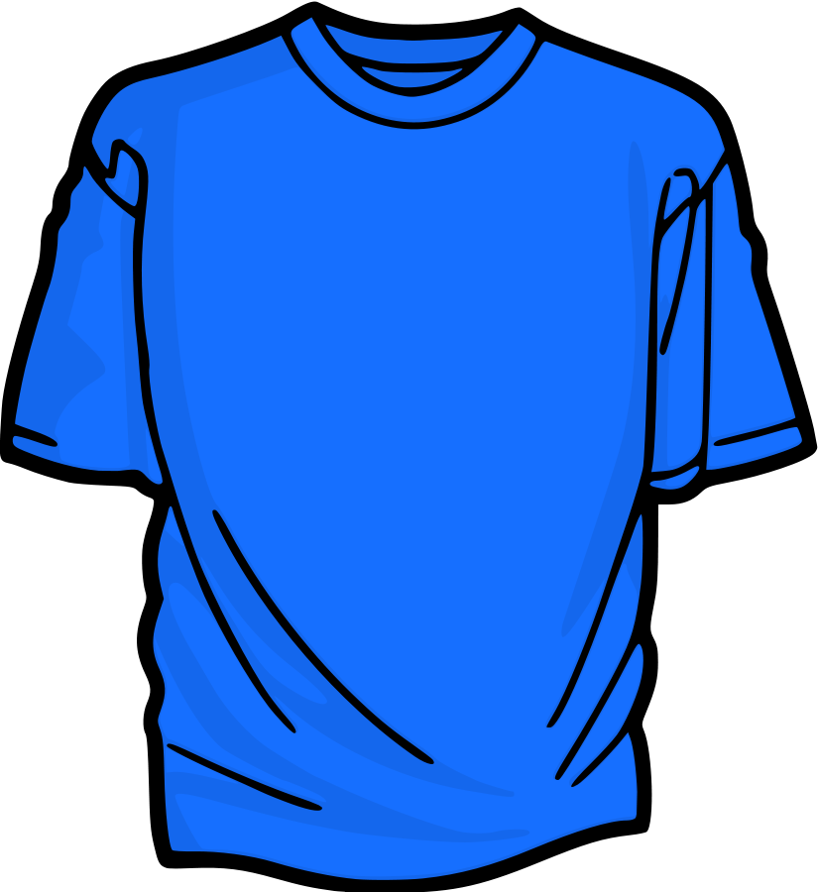
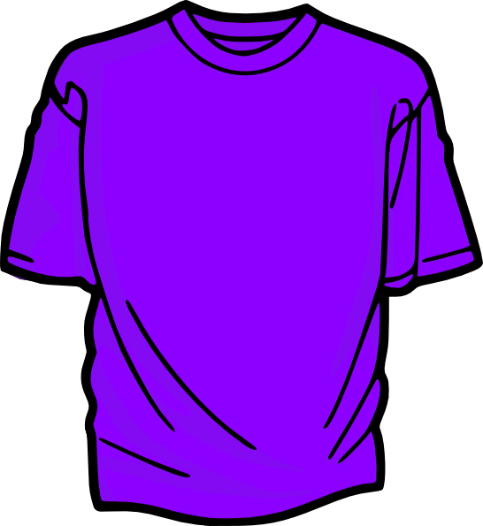
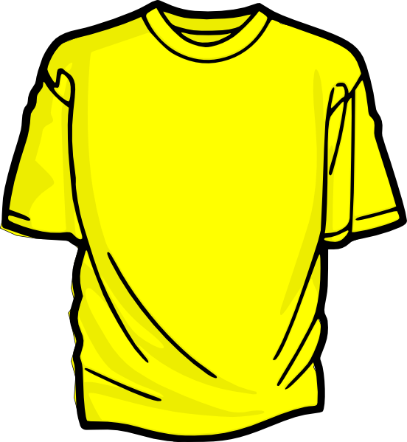
These
estas camisetas

Slide 3
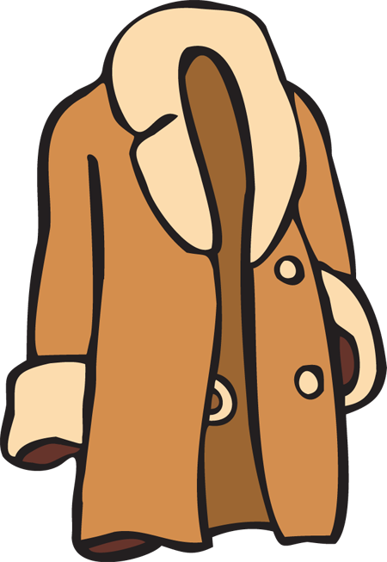
This
este abrigo

Slide 4
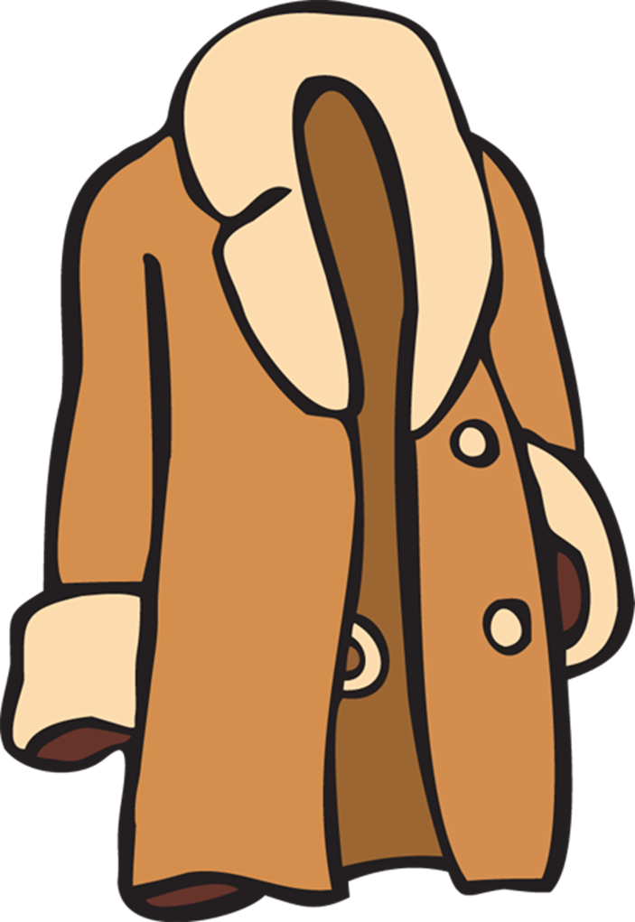
Those over there
Aquellos abrigos

Slide 5
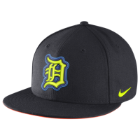
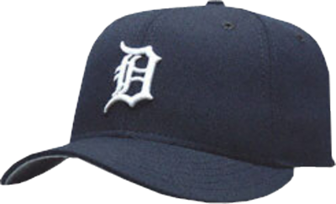
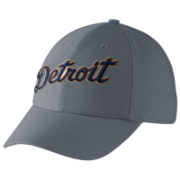
Those
esas gorras

Slide 6
That one over there
aquella gorra

Slide 7
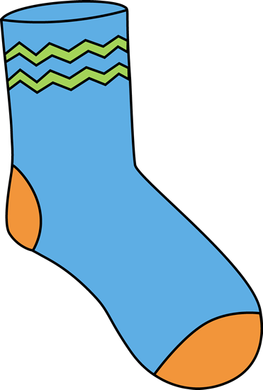
These
estos calcetines

Slide 8
Those
esos pantalones

Slide 9
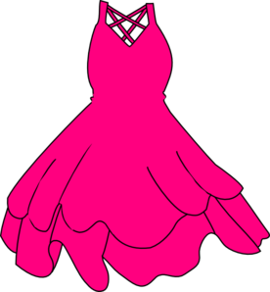
That one over there
aquel vestido

Slide 10
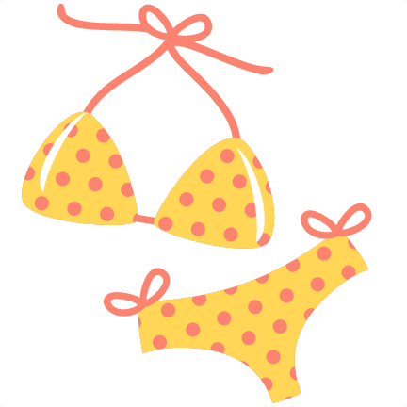
This
este traje de baño

Slide 11
those
esos trajes de baño

Slide 12
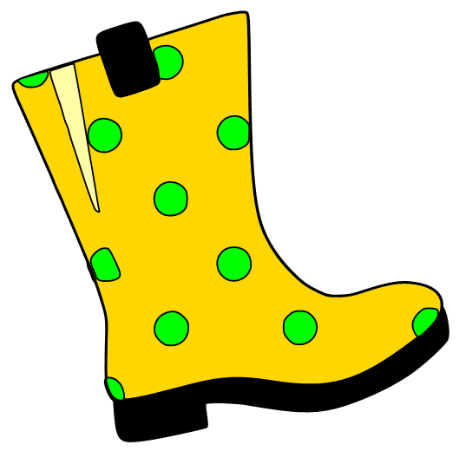
That
esa bota

Slide 13
These
estas botas

Slide 14
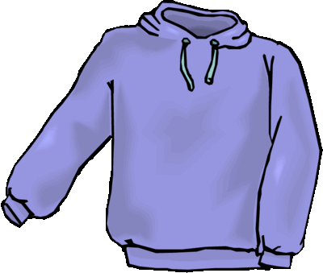
Those
esas sudaderas

Slide 15
That one over there
aquella sudadera

Slide 16
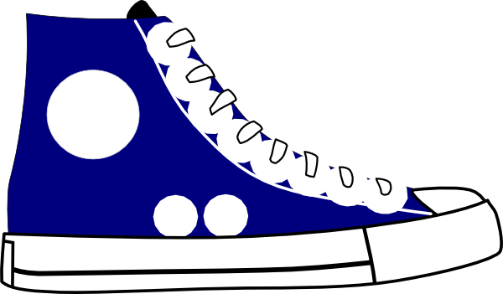
This
este zapato

Slide 17
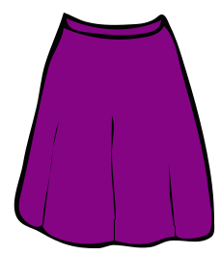
These
estas faldas

Slide 18
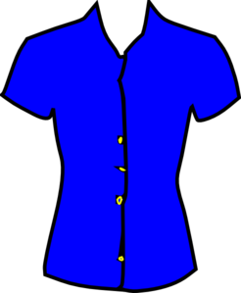
This
esta blusa

Slide 19
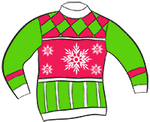
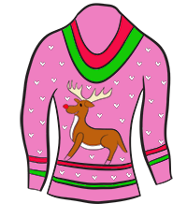
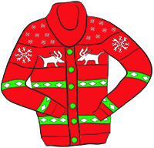
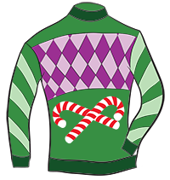
Those
esos suéteres

Slide 20
Quedar – How do we use quedar?
Translate:
1. These pants fit you very well and they are cheap!
2. This shirt fits her tight.
3. Those shoes fit me well and are very comfortable.

Slide 21
Quizzes next week:
Monday – Vocabulary – Mainly focused on clothing and weather. I’d know the descriptive words also.
Wednesday – Grammar – Present Progressive, Quedar, Demonstratives and Ser/Estar

Slide 22
Práctica:
Actividades de Escuchar:
7 y 8
Actividad de Quedar:
Quizizz – Quedar
Quizizz – Quedar 2 (Bowers created)
Quia –
W11 – Present Progressive
W11 – Demonstrative Adjectives
Actividad de Leer
Actividad de Comm.

