Slide 1
Phones in the pockets! Warm Up Look at your new vocab sheet – what are 3 activities you like to do? (write the Spanish words)

Slide 2
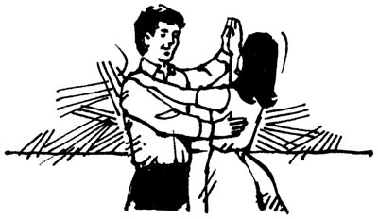
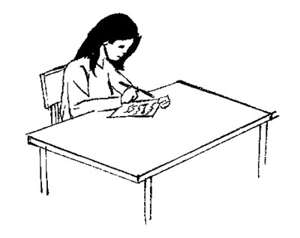
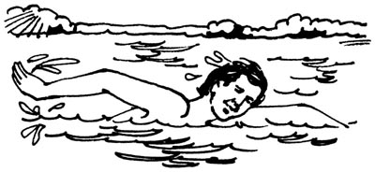
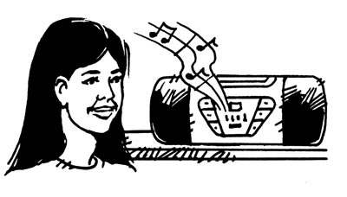
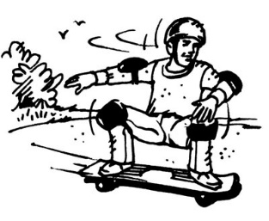
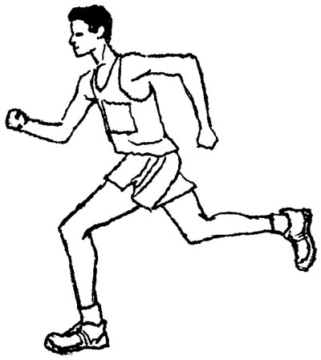
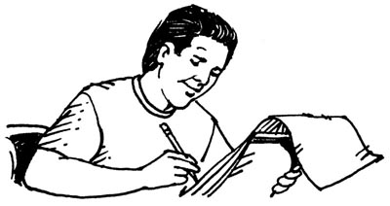
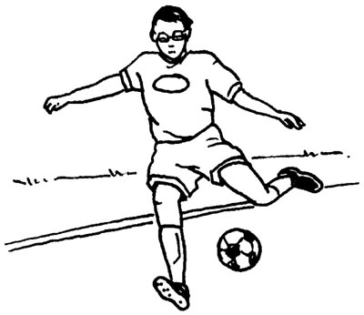
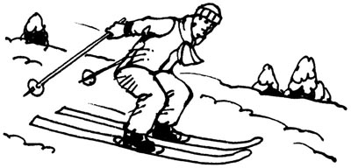
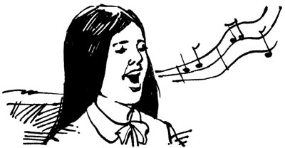
Ch. 1A Infinitive Verbs
bailar
escribir cuentos
nadar
montar en monopatín / andar en patineta
escuchar música
correr
dibujar
practicar deportes
esquiar
cantar

Slide 3
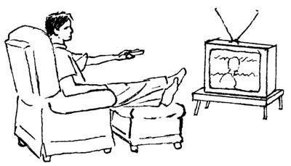
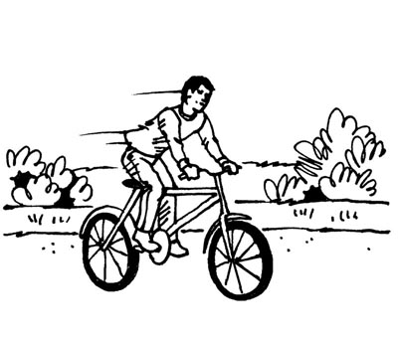
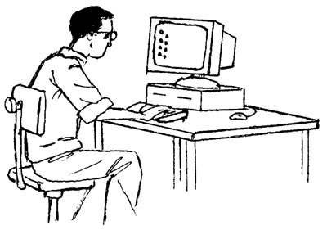
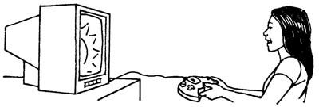
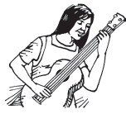
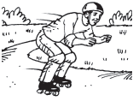
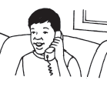
Ver la tele
Patinar en linea
Montar en bicicleta
Tocar la guitarra
Usar la computadora
Jugar videojuegos
Hablar por teléfono
Leer revistas

Slide 4
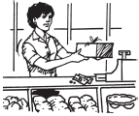
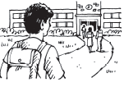
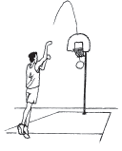
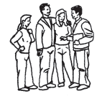
Jugar al baloncesto
Trabajar
Ir a la escuela
Pasar tiempo con amigos
Usar el (teléfono) celular

Slide 5
GUSTAR
(Not really “to like”)

Slide 6
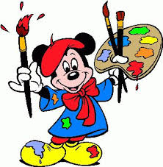
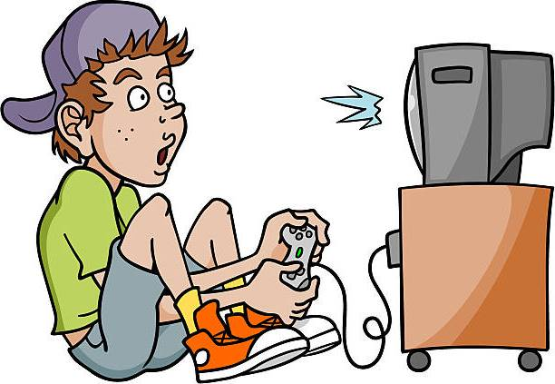
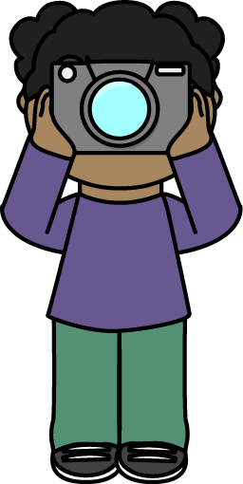
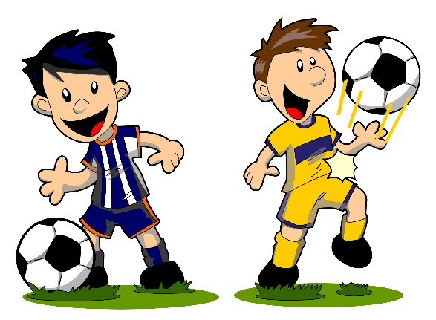
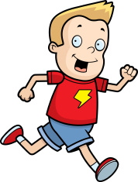
¿Qué te gusta hacer? -What do you like to do?

Slide 7
GUSTAR = To be pleasing to (to like)
The verb “gustar” can NOT be translated literally to mean “to like.”
“Gustar” really means:
something/somebody is pleasing to (a person)
I like apples = Apples are pleasing to me.
Casey likes to swim = Swimming is pleasing to Casey.
We like pizza = Pizza is pleasing to us.
They like to watch tv = Watching tv is pleasing to them.

Slide 8
English vs. Spanish
In English, the person (subject) is the one doing the liking.
Ex) I like chocolate.
Ex) We like to go to the movies.
In Spanish, the object is doing the action of “pleasing” the person. The person is the receiver of the pleasure that the object gives. So essentially, the sentences are read backwards.
Ex) Chocolate pleases me.
Ex) Going to the movies pleases us.

Slide 9
A little Grammar…
To use the verb GUSTAR correctly, you need to use Indirect Object Pronouns instead of the Subject Pronouns you have grown used to because we are now receivers rather than the ones doing the action.
Me = (to me) Nos = (to us)
Te = (to you inf.) Os = (to y’all) **Spain
(to him)
(to her) (to them)
(to you formal) (to you all)
(to “it”)
Le Les

Slide 10
The simple answer…
GUSTA (infinitive verb(s) / 1 object)
GUSTAN ( 2 or more objects)
Me
Te
Le
Nos
Os
Les

Slide 11
Examples with infinitive verbs
1) I like to paint = Painting pleases me
Me gusta pintar.
2) You like to play soccer = Playing soccer pleases you
Te gusta jugar al fútbol
3) She likes to swim = Swimming pleases her
Le gusta nadar

Slide 12
More examples with infinitive verbs
4) We like to study Spanish = Studying Spanish pleases us
Nos gusta estudiar el español
5) Y’all like to dance = Dancing pleases y’all
Os gusta bailar
6) They like to sing = Singing pleases them
Les gusta cantar

Slide 13
Multiple activities / verbs
For verbs, we ALWAYS use the singular form: “gusta” even when we are talking about multiple activities.
Ex) I like to sing, dance, and act.
Me gusta cantar, bailar, y actuar.
Ex) She likes to play soccer, ride bikes, and ski.
Le gusta jugar al fútbol, montar en bicicleta, y esqiuar.

Slide 14
Now you try…
We like to spend time with friends
He likes to play videogames
I like to swim and play baseball.
They like to draw and write stories.
You like to practice sports and walk.

Slide 15
Answers
We like to spend time with friends
Nos gusta pasar tiempo con amigos.
He likes to play videogames
Le gusta jugar videojuegos.
I like to swim and play baseball.
Me gusta nadar y jugar béisbol.
They like to draw and write stories.
Les gusta dibujar y escribir cuentos.
You (informal) like to practice sports and walk.
Te gusta practicar deportes y caminar.

