Slide 1
¡Bienvenido/a a la clase de Español AP!
Por favor, escoge tu asiento

Slide 2
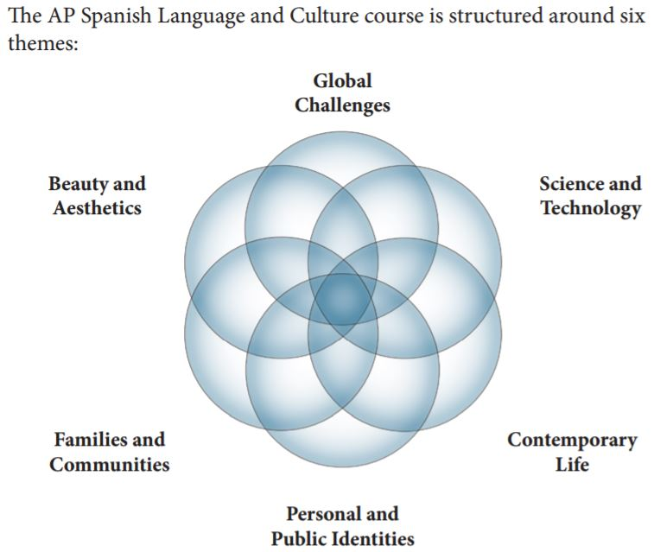

Slide 3
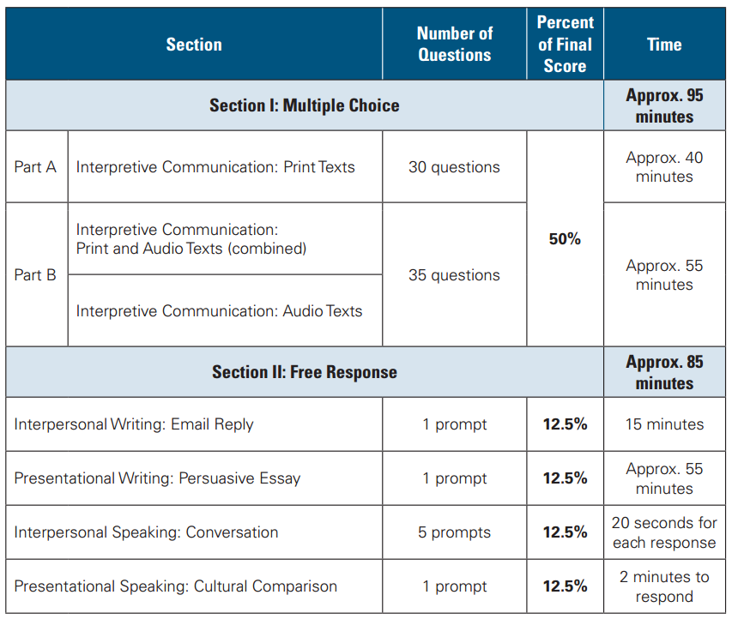
AP Exam Date:
Wednesday, May 10, 2023
@ 8:00 a.m.

Slide 4
AP Spanish Grading Categories
20% Listening:
Short / Long Dialogues Mult. Choice, Podcasts, Videos
20% Reading Comprehension: Expository / Fictional / Cultural texts, Plays, Poetry
20% Writing:
E-mails, Essays
20% Speaking:
Simulated conversations, cultural comparisons, dialogues, skits, oral presentations
10% Vocabulary: Quizzes
10% Final Exam:
AP Practice Exam released by College Board

Slide 5
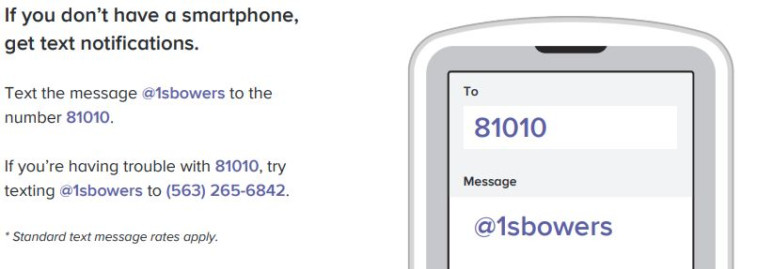

Slide 6
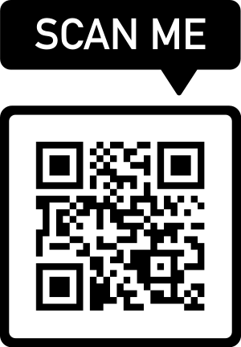
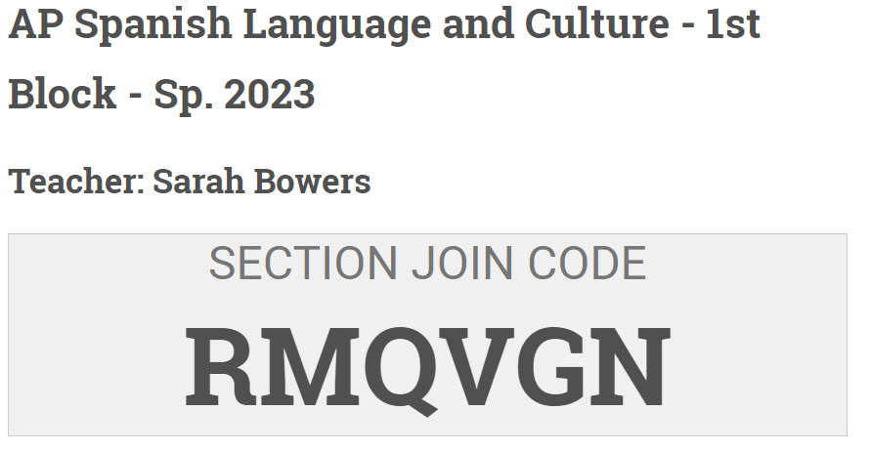
1. Visit: https://myap.collegeboard.org/
2. To enroll in this section online, either:
Create an account (if you’ve NEVER TAKEN an AP test before).
Sign into your existing College Board account (if you’ve taken an AP test before).
3. Enter the Section Join Code to enroll in the AP Classroom.

