Slide 1
Los teléfonos en la cajita, por favor Warm Up Translate: 1) Clara and Rita are smart, athletic, and pretty.
2) José is hardworking, funny, and social.

Slide 2
Los teléfonos en la cajita, por favor Warm Up: Translate: 1) Diego & Juan are young, daring, and extroverted 2) We are calm, practical, and patient

Slide 3
Comparisons
+ (más…que)
- (menos…que)
= (tan…como)

Slide 4
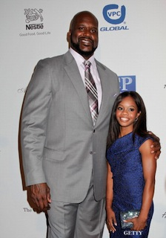
más (adj.) que
To say someone or something is more (adj.) than another person or thing, use this word formula:
Subject + ser + más adj. que + person/object
Shaq es más alto que Gabby.
The adjective used must match the # and gender of the subject.
Since “Shaq” is the subject, and he is male/singular, “alto” is the form of the adj. used.

Slide 5
más (adj.) que
To say someone or something is more (adj.) than another person or thing, use this word formula:
Subject + ser + más adj. que + person/object
Gabby es más baja que Shaq.
The adjective used must match the # and gender of the subject.
Since “Gabby” is the subject, and she is fem/singular, “baja” is the form of the adj. used.

Slide 6
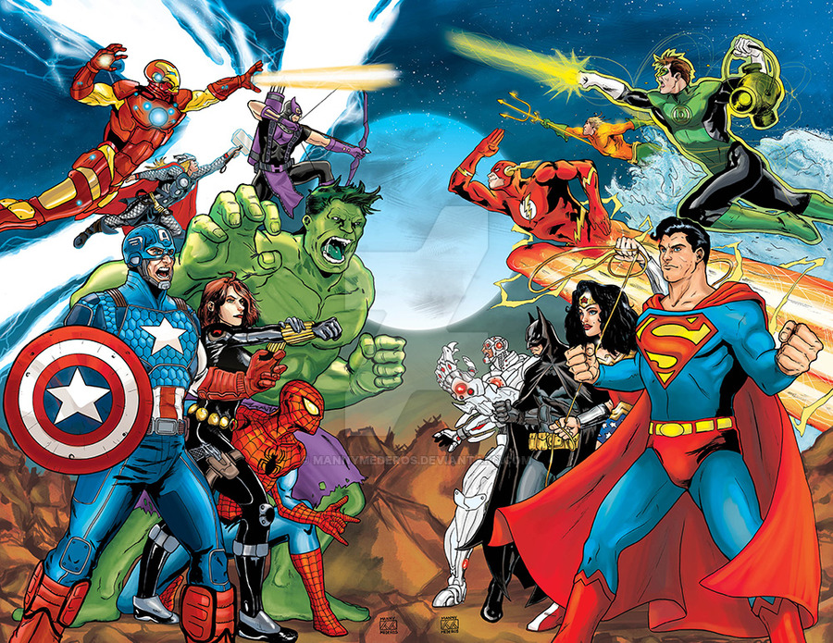
Los Avengers son más populares que el Justice League.

Slide 7
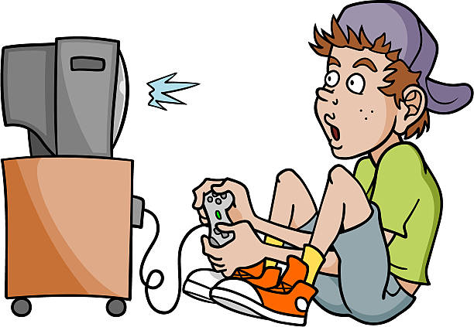
Las chicas son más estudiosas que el chico.

Slide 8
menos (adj.) que
To say someone or something is less (adj.) than another person or thing, use this word formula:
Subject + ser + menos adj. que + person/object
Yo soy menos rica que Bill Gates.
I am less rich than Bill Gates. / I am not as rich as Bill Gates

Slide 9
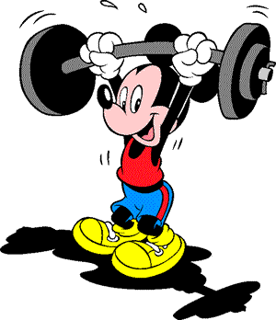
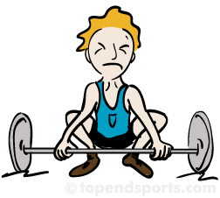
El chico rubio es menos fuerte que Mickey

Slide 10
tan (adj.) como
To say someone or something is as (adj.) as another person or thing, use this word formula:
Subject + ser + tan adj. como + person/object
David Chapelle es tan gracioso como Kevin Hart
David Chapelle is as funny as Kevin Hart.

Slide 11
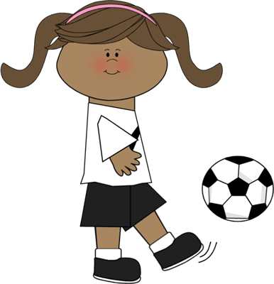
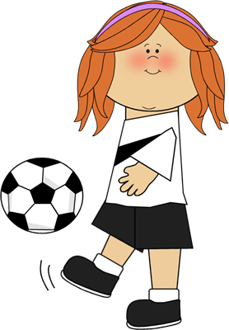
La chica morena es tan deportista como la chica pelirroja.

Slide 12
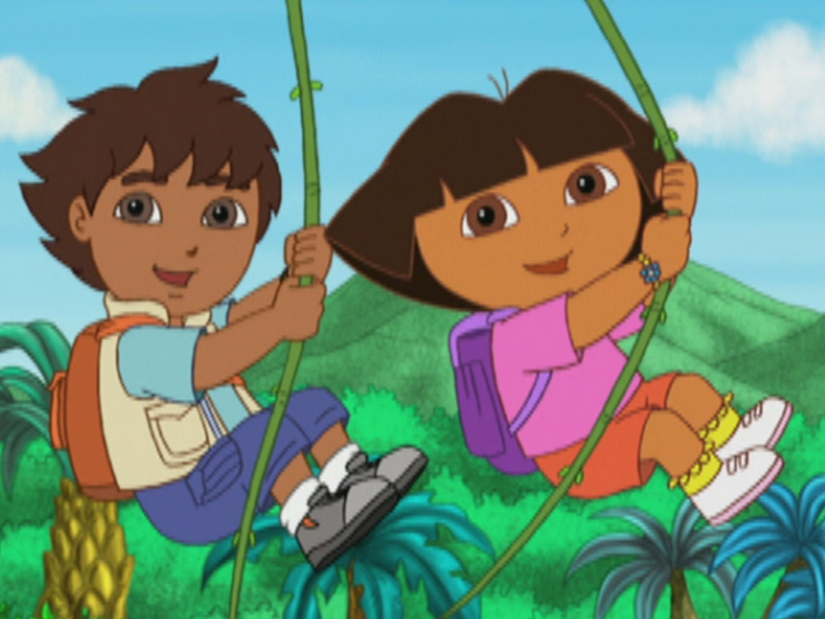
Dora es tan atrevida como Diego. Diego es tan atrevido como Dora.

Slide 13
Irregular Comparisons
Bueno(a) = Good
Even in English, we can’t say something is “gooder” or “more good.” We have to say “better”
In Spanish, the phrase is “mejor que…”
Ex) Ronaldo es mejor que Messi.
Ex) Nosotros somos mejores que ellos.

Slide 14
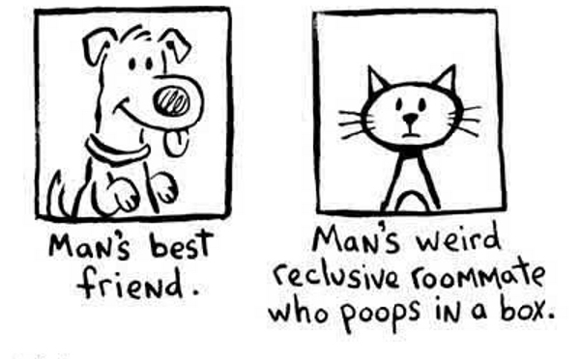
Irregular Comparisons
Malo(a) = Bad
Even in English, we can’t say something is “badder” or “more bad.” We have to say “worse”
In Spanish, the phrase is “peor que…”
Ex) Los gatos son peores que los perros.
Ex) Snape es peor que Dumbledore

Slide 15
Irregular Comparisons
Mayor que… (Older than)
Yo soy mayor que Uds.
Mi papa es mayor que yo.

Slide 16
Irregular Comparisons
Menor que… (Younger than)
Uds. son menores que yo.
Hector es menor que su hermano.

Slide 17
I am nicer than my sister.
You (informal) are fatter than Jose.
The cats are not as smart as the dogs
Catalina is as artistic as me.
We are prettier than them.
Susy is taller than Emily.
Hillgrove is better than McEachern.
You are older than Ken.

